Slide 1


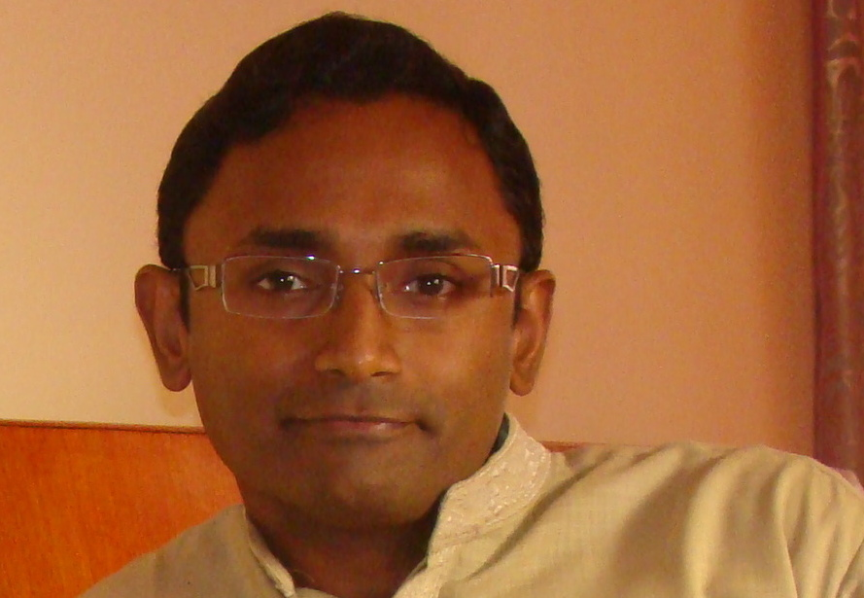
Suresh Sivaraman
Founder
MBA (PGSEM) from IIM Bangalore
Worked as Delivery Manager in Wipro Technologies
Certified Coach from Neuro Leadership Group
Certified NLP Trainer & Life Coach (ANLP)
Over 16 years of corporate experience
Extensive work experience in India and Europe
1

Slide 2
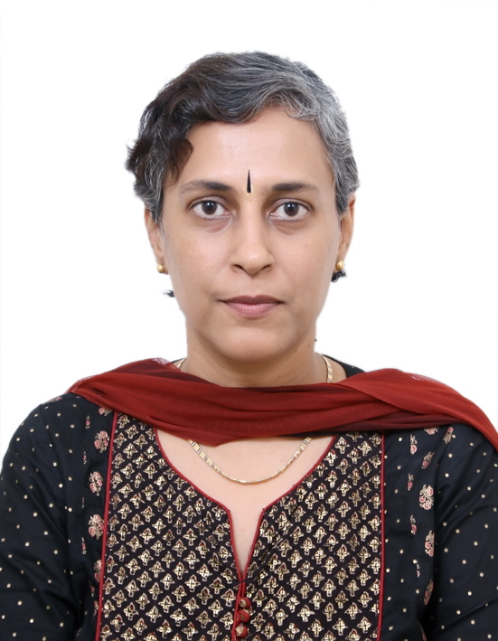
Archana Krishnamurthy
Motivational Speaker and Certified Leadership Coach
Ex Regional Director, ASSOCHAM
Is certified by Franklin Covey Institute, Australia as Leadership Coach.
Works closely with Governments and Trade & Industry Associations in various senior positions.
Over 22 years of experience in corporate life.
Has been an entrepreneur for over 12 years.
Is Founder Director of CorNet PR - which is into Corporate Networking and servicing M&E segment.

Slide 3
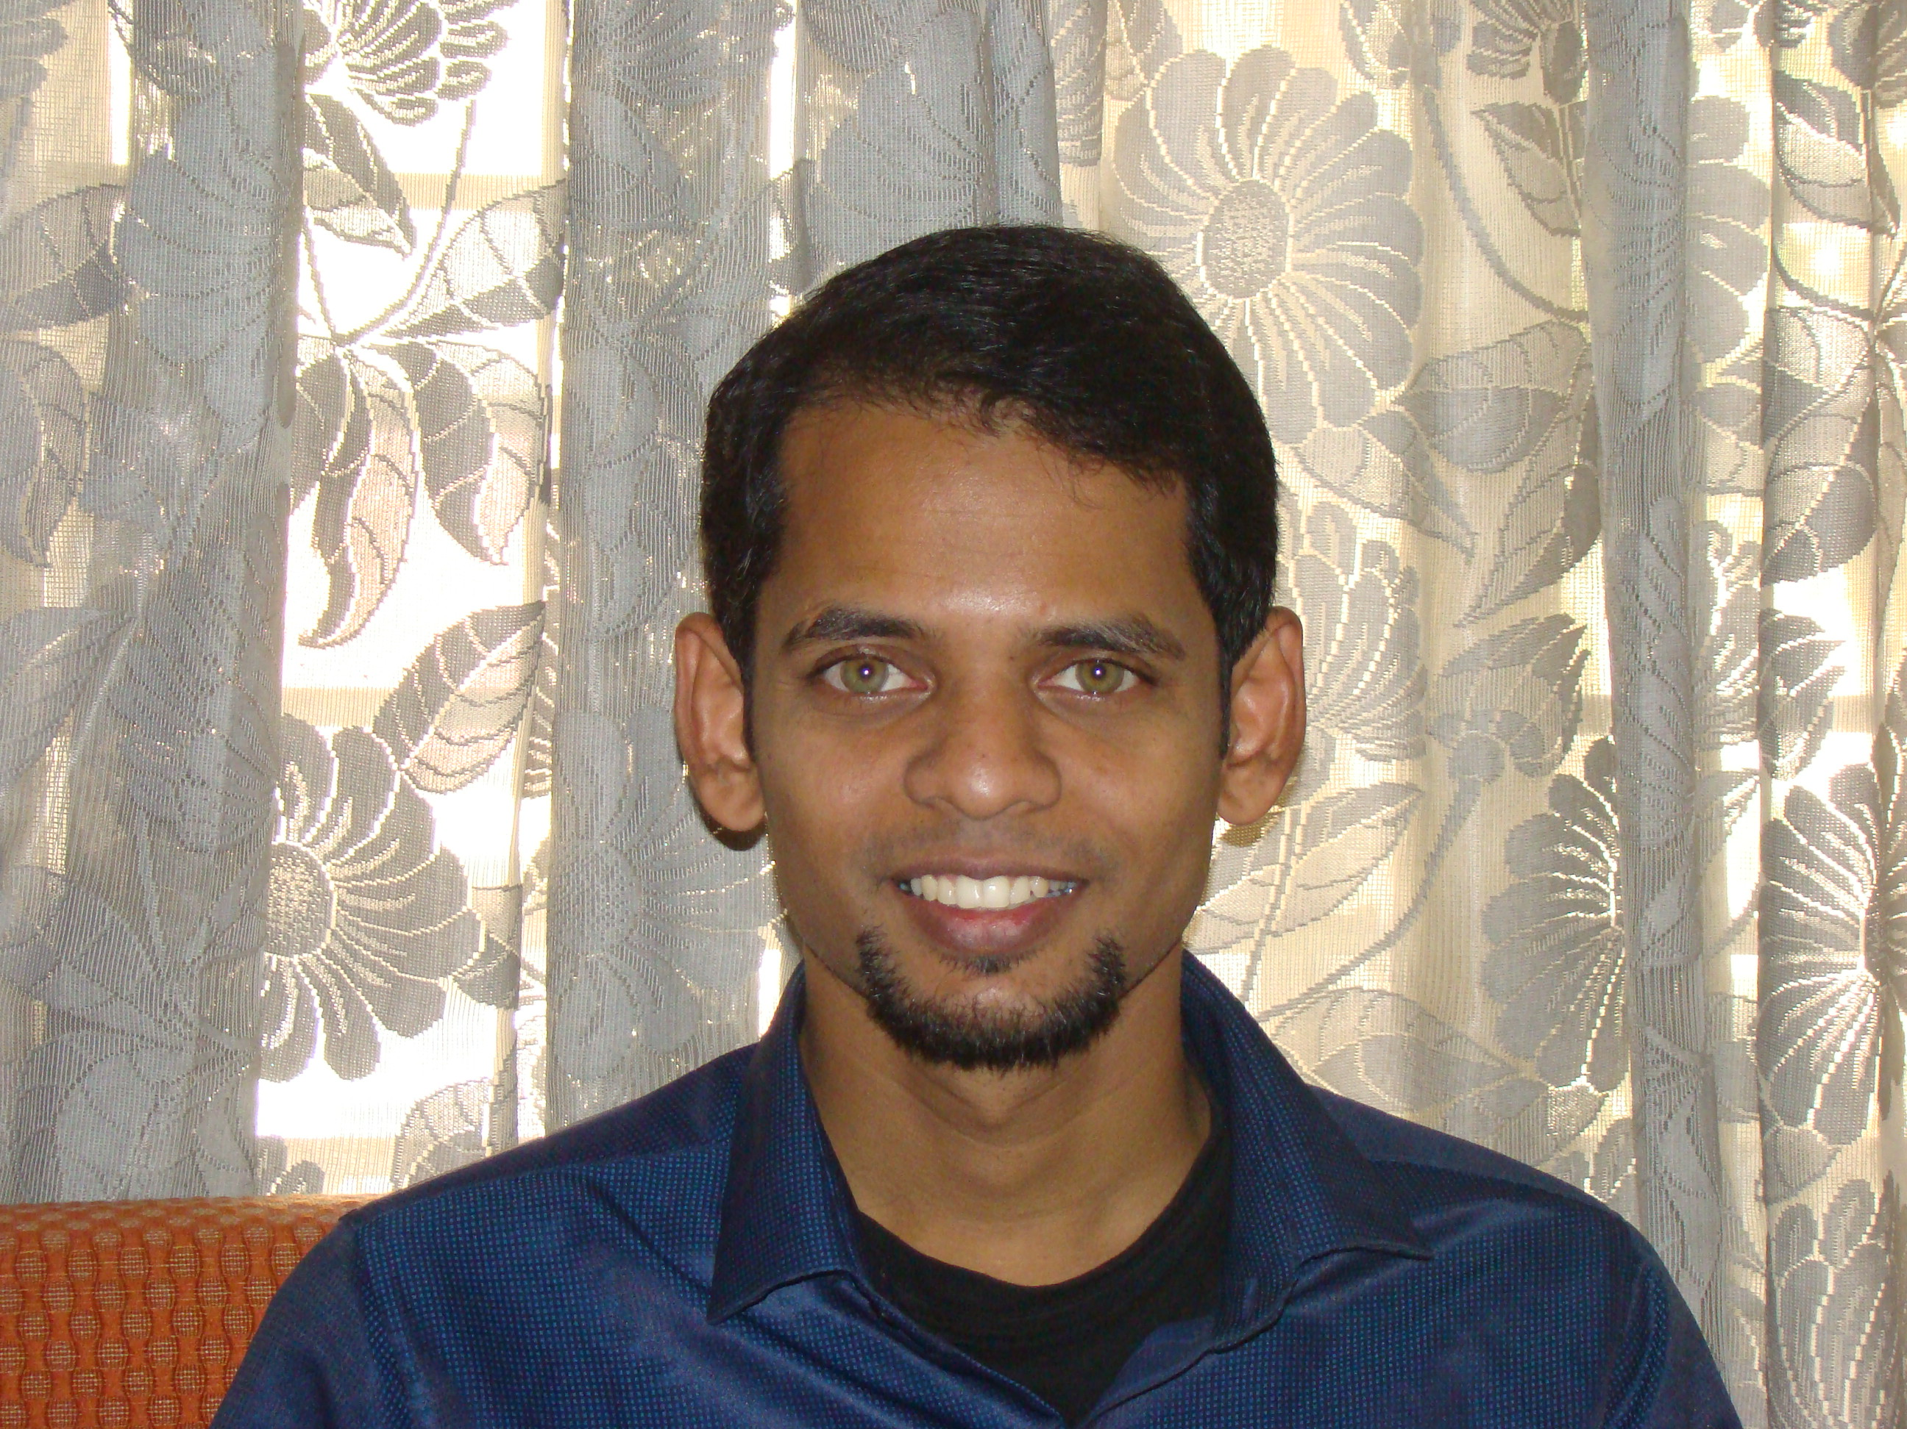
Corporate Trainer, Entrepreneur
Raphael Joseph
Corporate Trainer in Leadership, Behavioural & Sales with varied industrial experience
Organizes open workshops with Times of India group
Previously worked as Asst. Team lead in Technicolor India; star performer of gaming unit
Guest Lecturer and Mentor for ‘Arena Multimedia’ and ‘Image Multimedia’
Actively partnered with YMCA in organizing youth camps, and drug de -addiction camps
Organized youth empowerment programs
Rich philosophical and psychological back ground

Slide 4
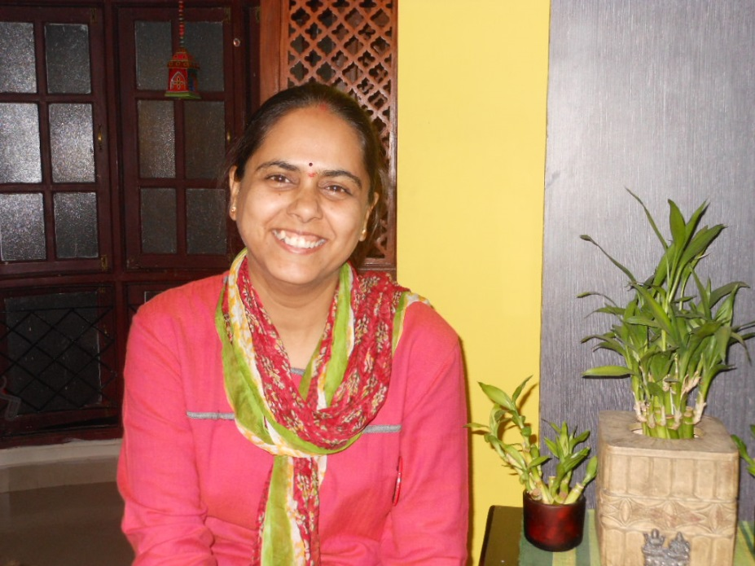
Visionary Social Entrepreneur,
Trainer & Consultant
Prarthana Prateek Kaul
Guest Speaker at different institutes including IIT Chennai, IIMB, NMIMS, TISS
Visionary Social Entrepreneur: founder of Giftabled (an inclusive gift store)
Consultant and Trainer – Rediscover your passion, Volunteering, Disability Awareness
10 years of extensive NGO & Volunteering Experience in India
  Regional Head – East and South at iVolunteer for 8 years
  On Board of Om Ashram, an Old Age Home in Bangalore.
  Trained in using “Basic Sign language” and “Basic Uncontracted Braille”
PGDBA (Finance) from Symbiosys Centre for Distance Learning
Worked as Sr. Procurement Specialist in IBM

Slide 5
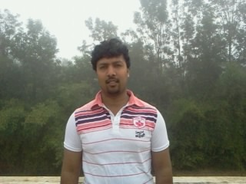
Senior Corporate Training Consultant & Trainer
Xavier J Stalin
“General Management & Entrepreneurship” from IIM-B
“Leadership & Personal Excellence” using NLP techniques from St. Joseph’s College
“Training Need Analysis & Risk Audit” from J.P. Morgan
“Facilitator Development” from Hero Mind Mine
Over 7 years of experience in Behavioral & Corporate training.
Worked as an MBA Visiting Faculty in many reputed colleges.
Counseled over 500 people which includes students, employees, doctors & marries couples.
Have been a Corporate Trainer in many reputed companies.

